Slide 1
Warm Up – Sign the Attendance Sheet and Consider the Question Below
Which choices of the following best represents a “governing rule” (hint: BLW definition on page 85)?
A defendant’s conduct is extreme and outrageous if the conduct exceeds “all bounds tolerated by decent society.”
Reversed and remanded with instructions to enter judgment on the verdict as rendered by the jury.
In North Carolina, a claim for intentional infliction of emotional distress requires that the plaintiff prove that the defendant’s conduct (1) was extreme and outrageous; (2) was intended to cause severe emotional distress; and (3) did cause several emotional distress.
Defendant’s [acts]. . . all indicate a calculated, persistent plan to disturb, humiliate, harass, and ruin plaintiff for no purpose but defendant's own spiteful satisfaction.

Slide 2
Today’s Class
Preparing Case Briefs & Assessing a Clients Case - BLW Exercises
Introduction to our Client
Mustafa and Sobin Briefs and Analysis
Astro & Toro LLP– Presentations

Slide 3
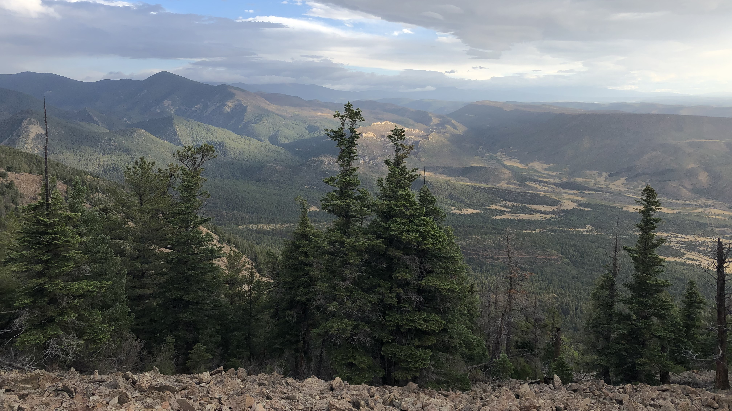
Parker Champagne

Slide 4
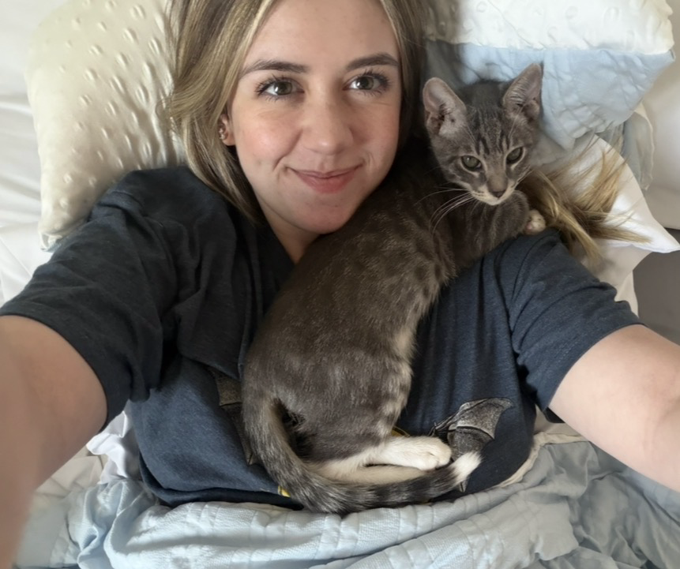
Madeline (maddy) Kampes
I was a psychology major at TAMU (class of '26) and worked as a Supplemental Instructor for Logic!
I have one kitten at home named Shark that I got August 2nd.
I love listening to the Eagles, RHCP, Nirvana, and a lot of similar music.
I think I am interested in transactional law, but I'm not sure what sector!
I was born in Germany; My mom, dad, and sister were all born in different countries :)
My hobbies are cooking, baking, playing video games, and watching football (Eagles fan).

Slide 5
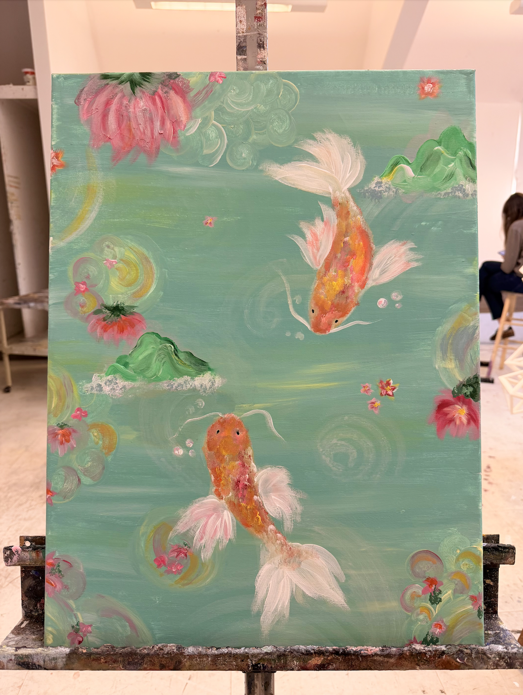
Emily Moon
Acrylic Painting
A representation of my Culture, Interests, and personality
Korean Culture
Significance of Goldfish
Mountain Landscapes
Love for the ocean
Traveling to tropical destinations
Water activities/Swimming
Personality
Artistic Hobbies
Optimism

Slide 6

Lawyering Skills & Strategies
Legal Analysis –
What is “The Law”?
How to Apply the Law to a Set of Facts
Legal Research - How to Find It
Legal Communication -How to Write About It

Slide 7
Let’s Discuss
Which choices of the following best represents a governing rule?
A defendant’s conduct is extreme and outrageous if the conduct exceeds “all bounds tolerated by decent society.”
Reversed and remanded with instructions to enter judgment on the verdict as rendered by the jury.
In North Carolina, a claim for intentional infliction of emotional distress requires that the plaintiff prove that the defendant’s conduct (1) was extreme and outrageous; (2) was intended to cause severe emotional distress; and (3) did cause several emotional distress.
Defendant’s [acts]. . . all indicate a calculated, persistent plan to disturb, humiliate, harass, and ruin plaintiff for no purpose but defendant's own spiteful satisfaction.

Slide 8
Definitions
Governing rule – the overarching legal principal that applies to a legal issue.
Sub-rule – components of the governing rule, such as factors (“or”), elements (“and”), or definitions.

Slide 9
Becoming a Legal Writer Exercises
Exercise 3.3.1
Exercise 1.1 (Questions 1-3)

Slide 10
Welcome to the Law Firm of Feinstein, Gomez, Reed, and Truskett LLP
Serving Clients with Excellence

Slide 11
What have you been asked to analyze?
Who is our client? What is the Issue?

Slide 12

Careful Reading Quiz

Slide 13
Deep Reading
Get Context
Skim the Case
Close Read the Case
Name
Court
Year of Decision
Parties
Procedural History [if relevant]
Facts [only legally relevant]
Issue
Holding
Reasoning
Disposition
Takeaway Rule
The sample case brief on page 70-71 is a good example of how to capture the information from your close read

Slide 14
Take Away Questions FROM EACH ASSIGNED CASE
Why was this assigned to me?
Where does it fit in the class?
How does it fit with the other cases assigned in class?
How does this build on the last class?

Slide 15

Mustafa and Sobin, our precedents

Slide 16

Identifying and Extracting Rules

Slide 17
Legal Analysis: IRAC
Issue
Rule
Application
Conclusion
Notes:
THIS IS WHY WE BRIEF CASES TO TRACK THESE SAME TOPICS

Slide 18
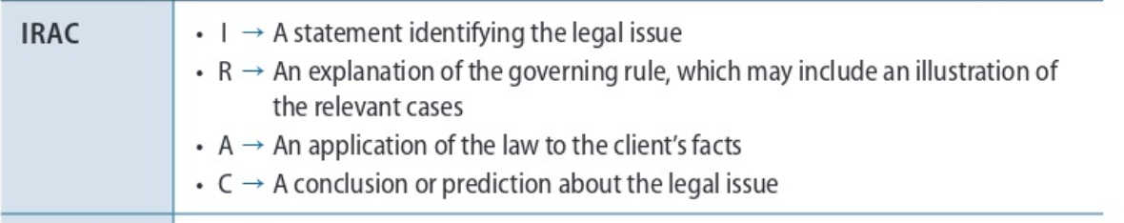
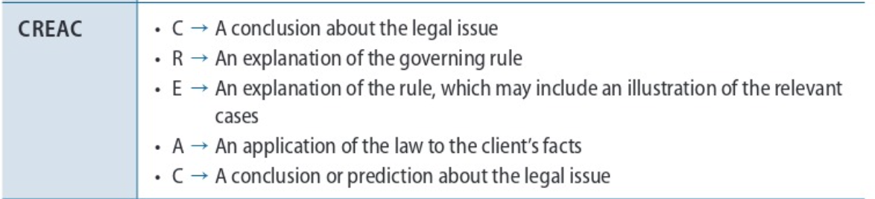
PREVIEW
Different Legal Writing Paradigms

Slide 19

How do we make a prediction based on past cases?

Slide 20
For Tuesday:
Firm 4 members send me a PPT slide by 2 p.m. Monday, 8/31
Read BLW Ch. 5; in lieu of Ch. 5 exercises, complete a case chart for Mustafa and Sobin
Mandatory 1L Research Lab, Tuesday, 9/1 (12:00 p.m. –Room 102A)
Complete Legal Research Modules 0.1-0.4 by 5:00 p.m. Tuesday, 9/1
Bring Bluebook to class, and make sure you have registered for LEXIS so you can access the ICW platform.
Starting in week 2, you will often need your Bluebook in class, as we will have citation practice regularly, even if not the main topic of the day. ICW Setup Guide in Student Resources on Canvas
(ICW Exercises 1 (questions: ALL except 9) and 2 (questions: 1-10 ) by Sunday, 9/6 at 5:00 p.m.

Slide 21

How do you manage stress or high-pressure circumstances? What are your coping mechanisms?

